Slide 1

ATAC-seq / scATAC-seq

Slide 2
Overview of content
Part I: Chromatin accessibility + early technologies
Part II: Bulk ATAC-seq, applications, and improvements
Part III: Single-cell ATAC technologies
Part IV: Single-cell analyses and new horizons

Slide 3
Part I: Chromatin accessibility + early technologies

Slide 4
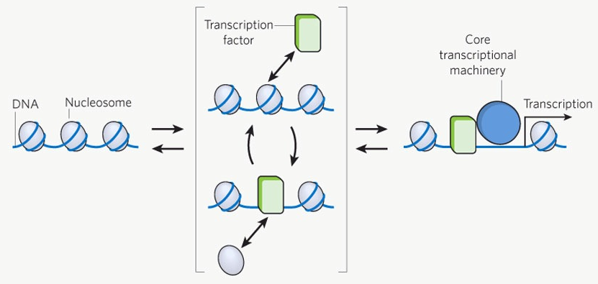
Chromatin accessibility mediates gene regulation
OFF
ON
Kaplan et al. Nature (2012)

Slide 5
How do we measure accessible chromatin?

Slide 6
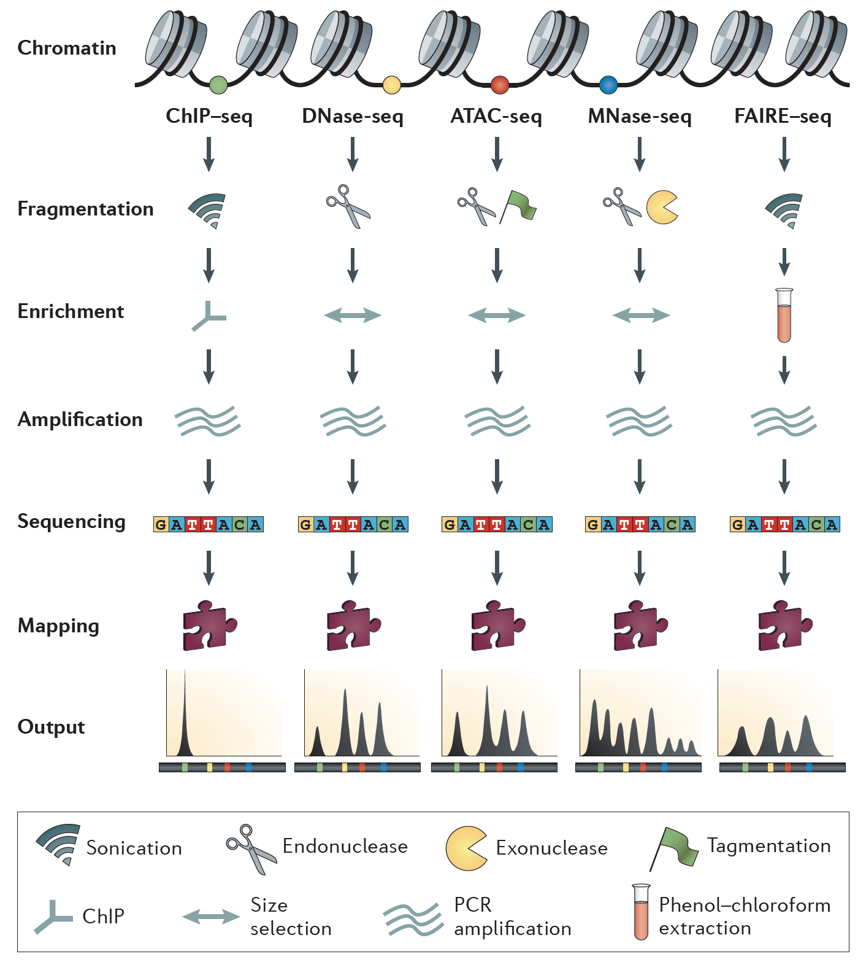
Meyer and Liu. NRG (2014)

Slide 7
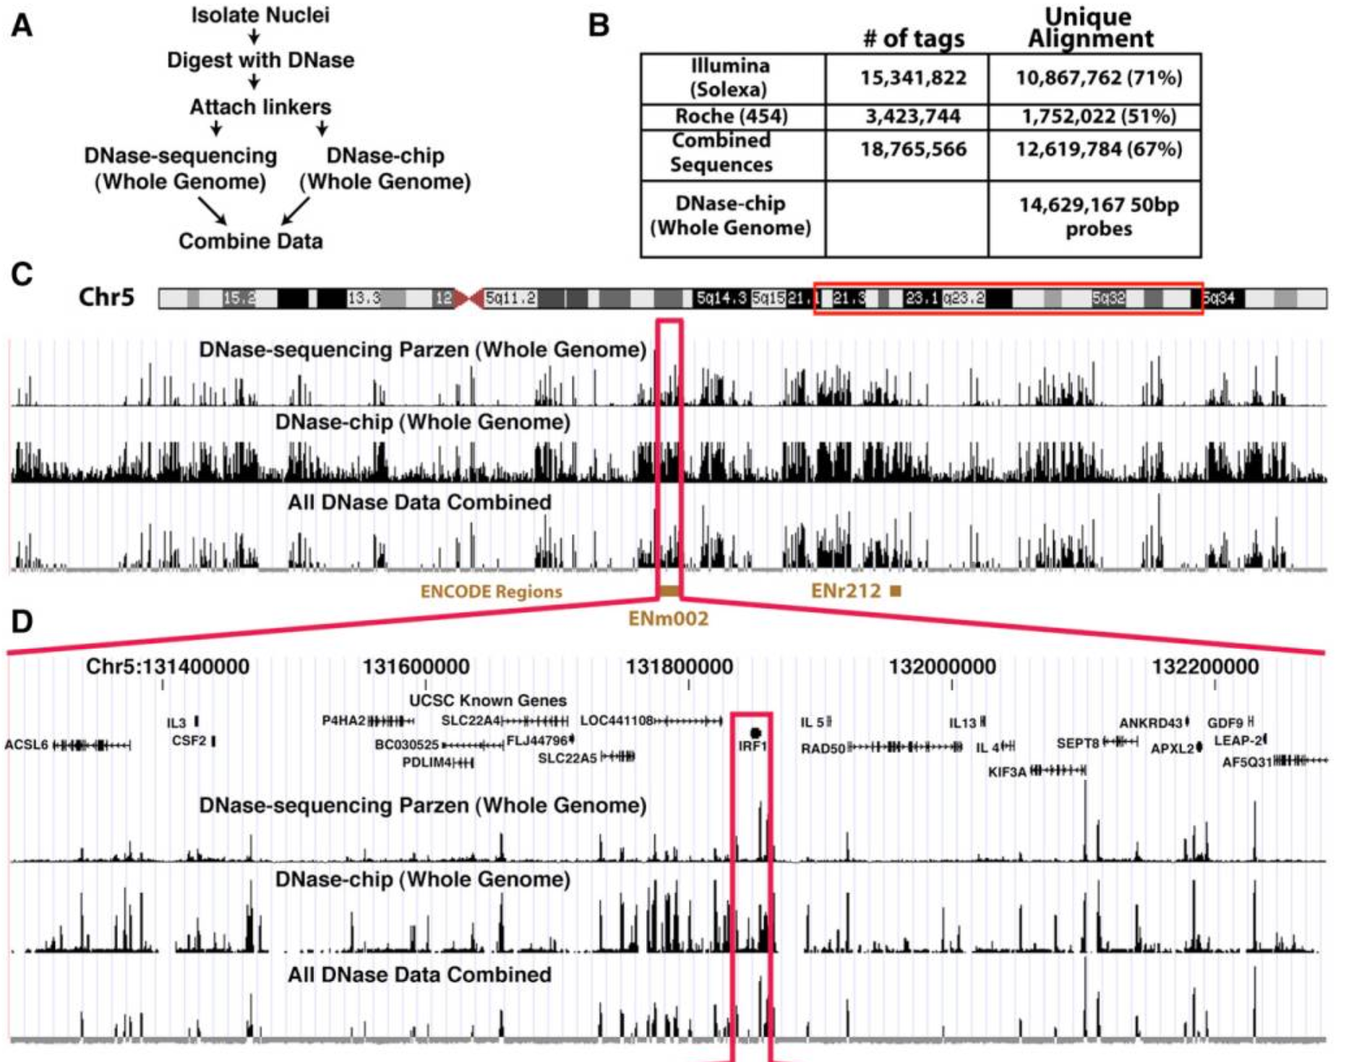
Finding accessible chromatin via DNase-seq
Boyle…Crawford et al. Cell (2008)

Slide 8
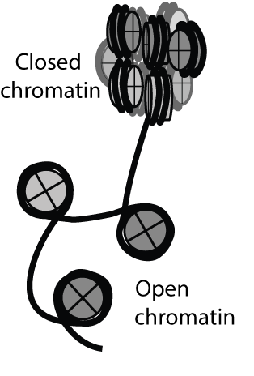

DNase-seq is a relatively inefficient library protocol
DNaseI treatment
Prepare library from fragmented ends and sequence
*44 total steps, steps condensed/removed for graphic, generally requires ~100M cells
Song and Crawford, CSH protocols (2010)

Slide 9
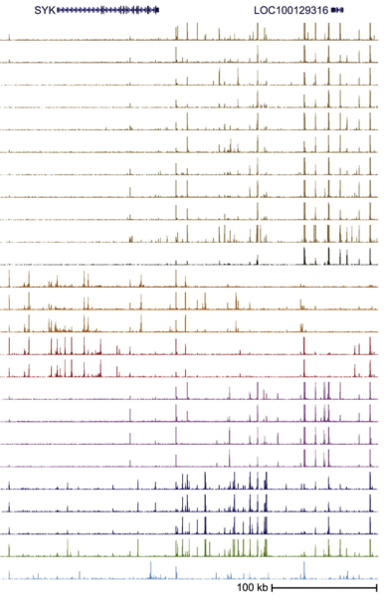



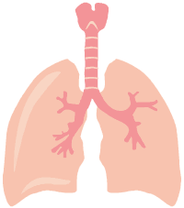
Averaging over cellular heterogeneity
Prepare
libraries
Stergachis et al. Cell (2013)

Slide 10
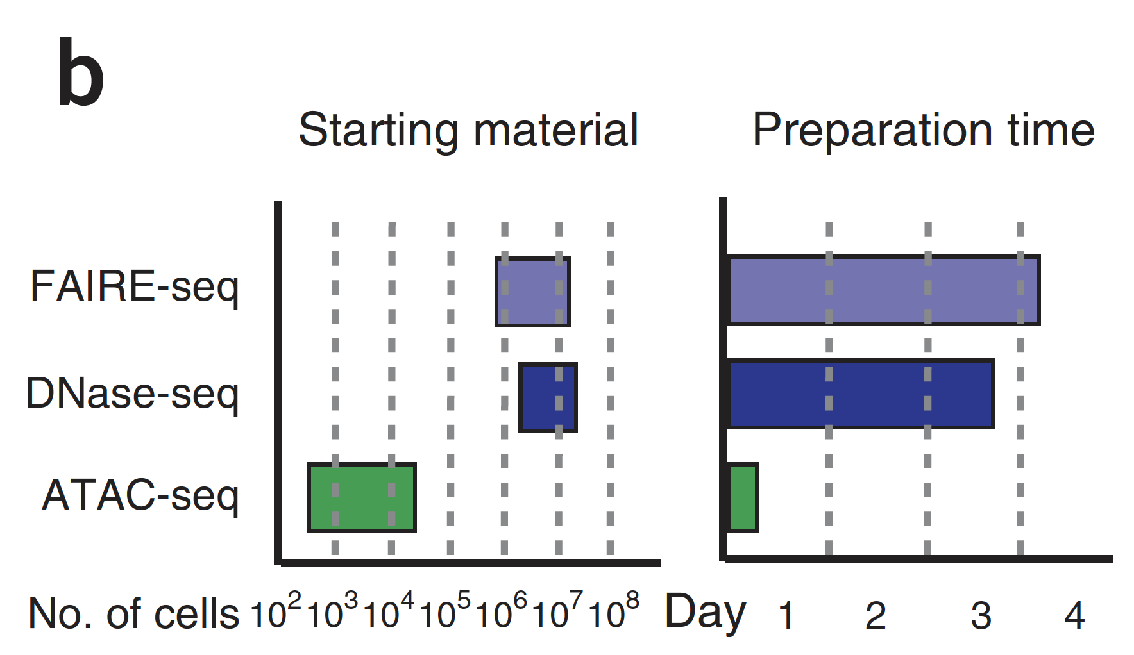
ATAC-seq– an improved epigenomic protocol
Buenrostro et al. Nature Methods (2013)

Slide 11
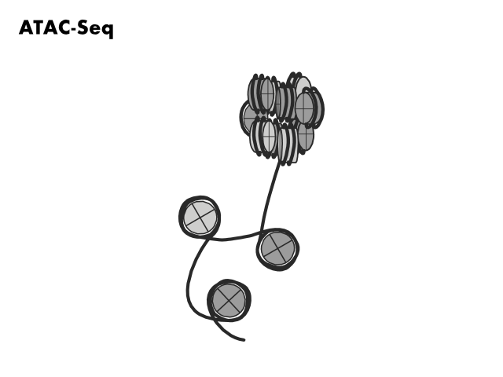

Slide 12
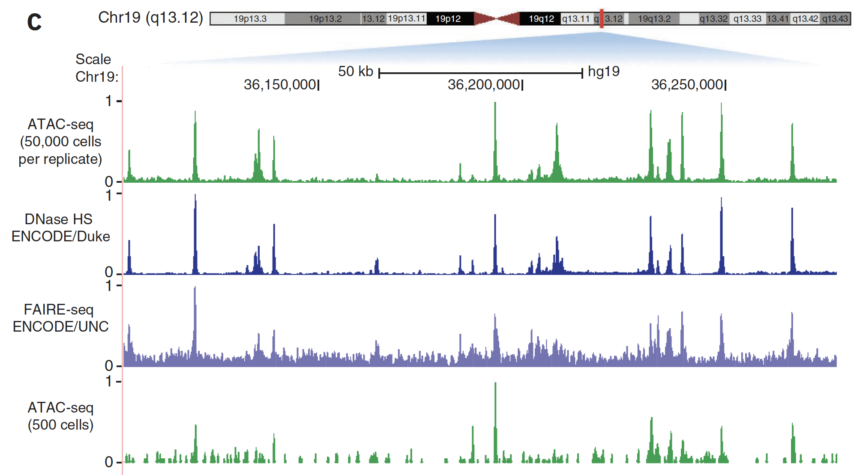
Accessible chromatin landscapes with ATAC-seq
Buenrostro et al. Nature Methods (2013)

Slide 13
Part I Summary
Accessible chromatin is a key mediator of gene expression
Pre-2013 technologies (FAIRE, DNase, and MNase-seq) enabled profiling of accessible chromatin regions that are essential for gene regulation
ATAC-seq (2013) provided a far more efficient protocol for mapping accessible chromatin in fewer cells and in less time
The efficiency gains in ATAC-seq are due in part to tagmentation (adding sequencing adapters) and endonuclease (cutting at accessible chromatin) in one step

Slide 14
Part II: Bulk ATAC-seq

Slide 15
What can bulk ATAC-seq do for you?
Accessible chromatin landscapes
Nucleosome occupancy maps
Transcription factor footprints

Slide 16
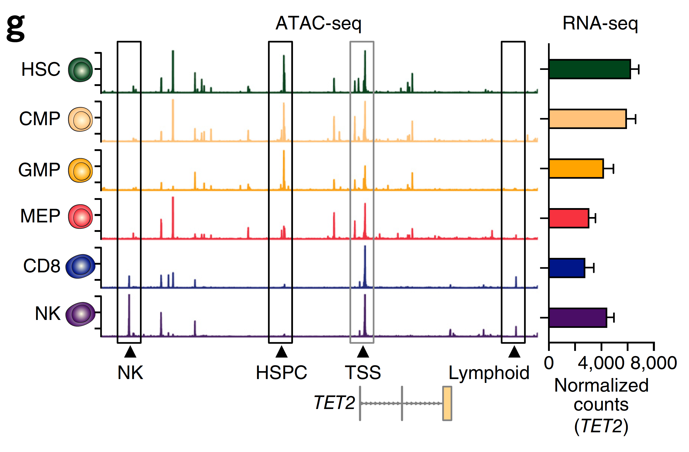
1. Accessible chromatin landscapes
Corces et al. Nature Genetics (2016)

Slide 17
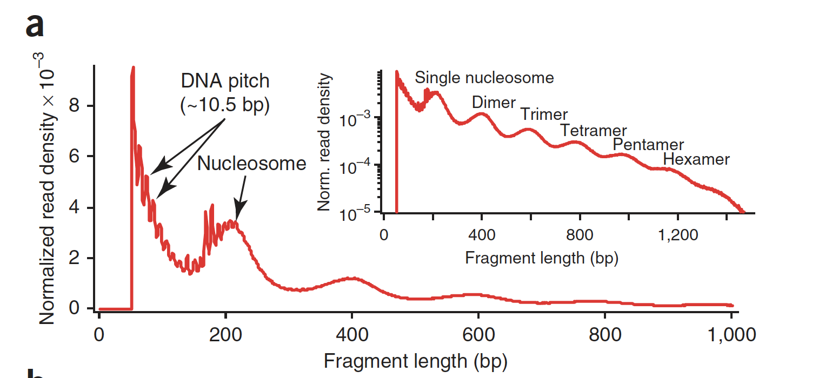
ATAC-seq fragment products
Buenrostro et al. Nature Methods (2013)

Slide 18
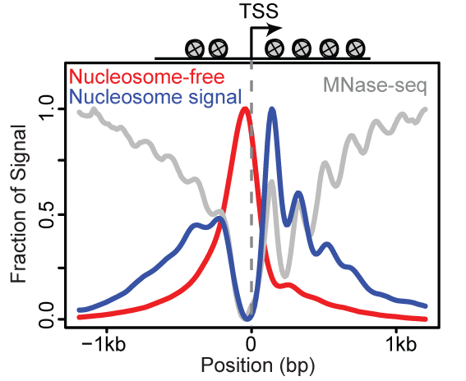
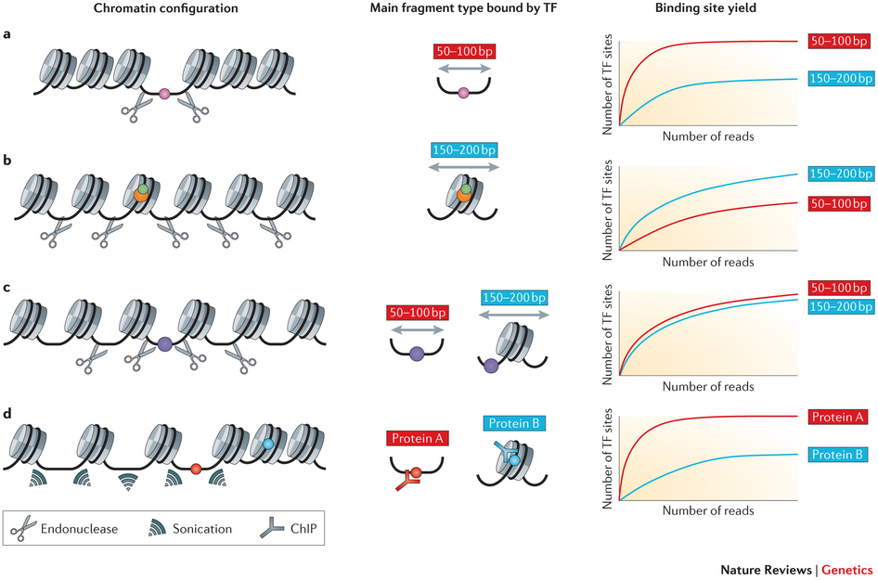
Types of fragments – ATAC-seq
Buenrostro et al. Nature Methods (2013)

Slide 19
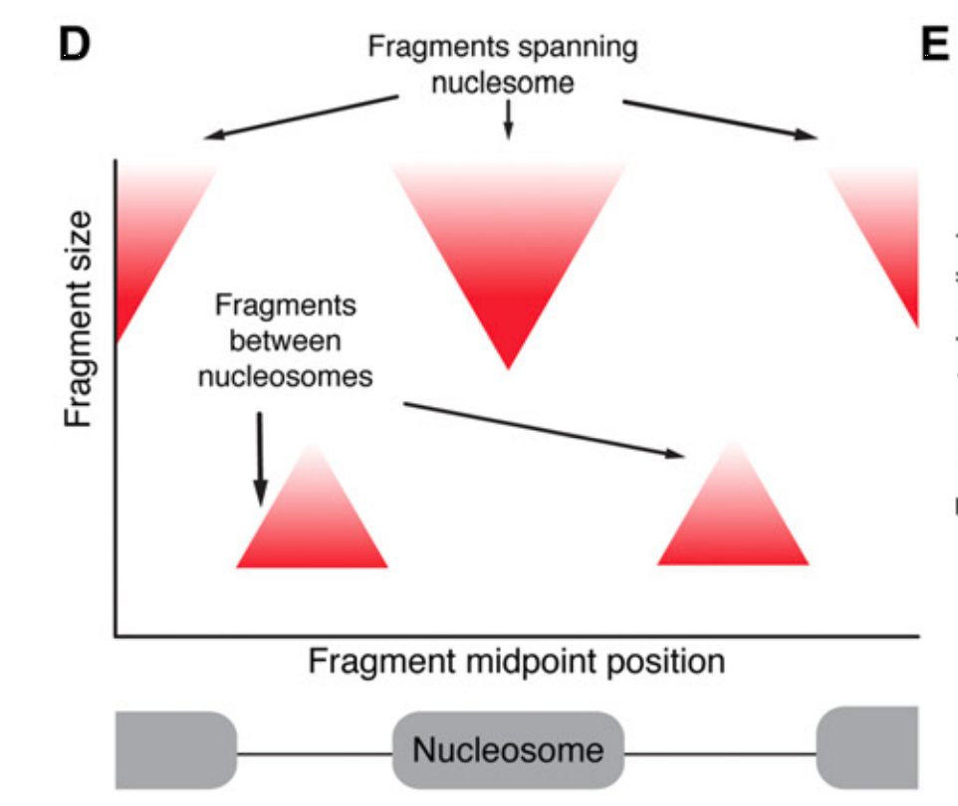
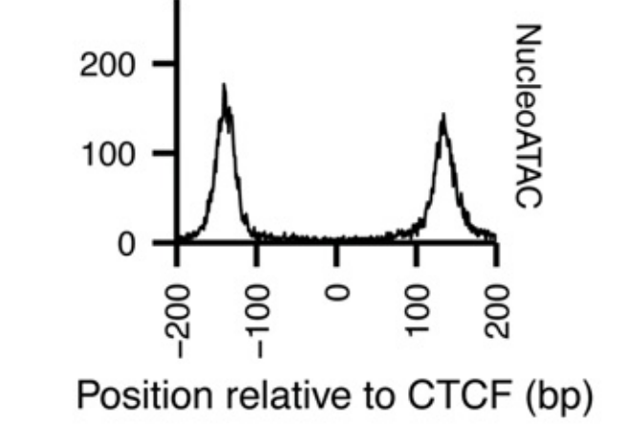
2. Nucleosome calling with ATAC-seq
Schep et al. Genome Research (2015)

Slide 20
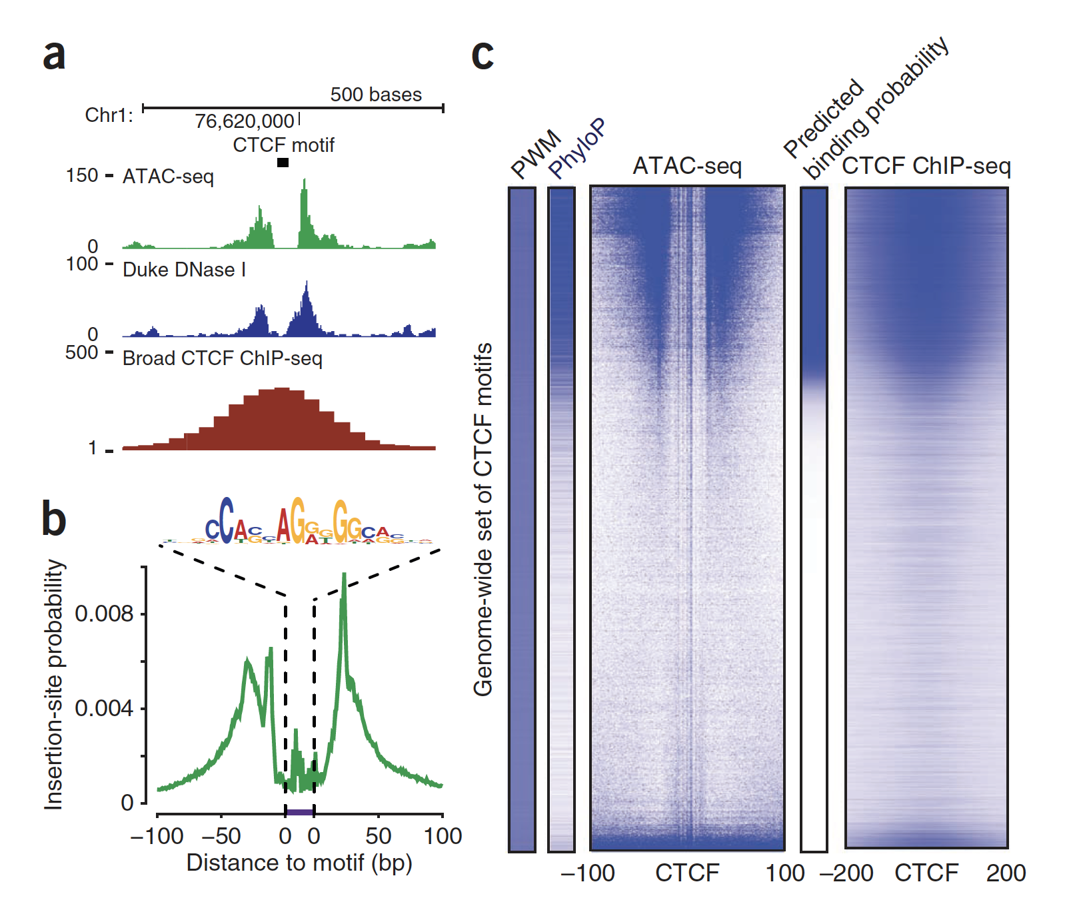
3. Tn5 cutsites enable factor footprinting
Buenrostro et al. Nature Methods (2013)

Slide 21
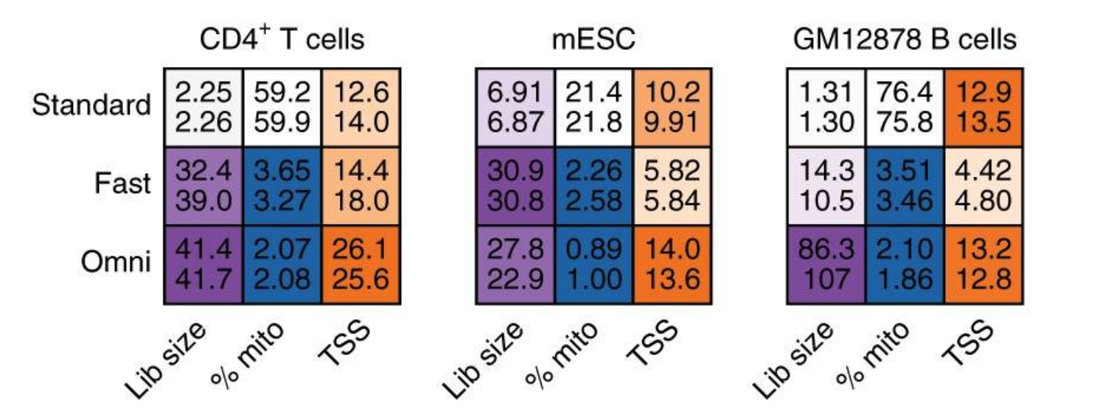
Newer versions of ATAC-seq
Fast-ATAC: Corces et al. Nat Genetics (2016)
Omni-ATAC: Corces et al. Nat Methods (2017)

Slide 22
Summary
ATAC-seq provides a rich data source to characterize nucleic acids and chromatin biology in cell types
Accessible chromatin may provide a more information-dense measure of cell state than transcriptomics
Newer versions of the ATAC-seq protocol (Fast and Omni) enhance data quality

Slide 23
Part III: Single-cell ATAC technologies

Slide 24
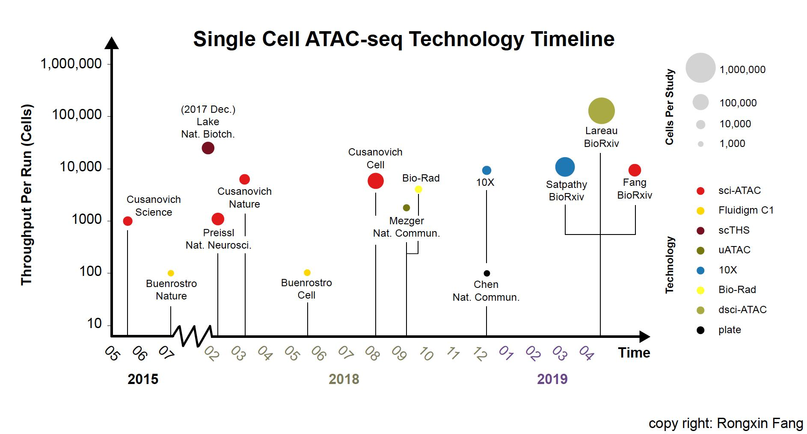
Credit: Rongxin Fang

Slide 25
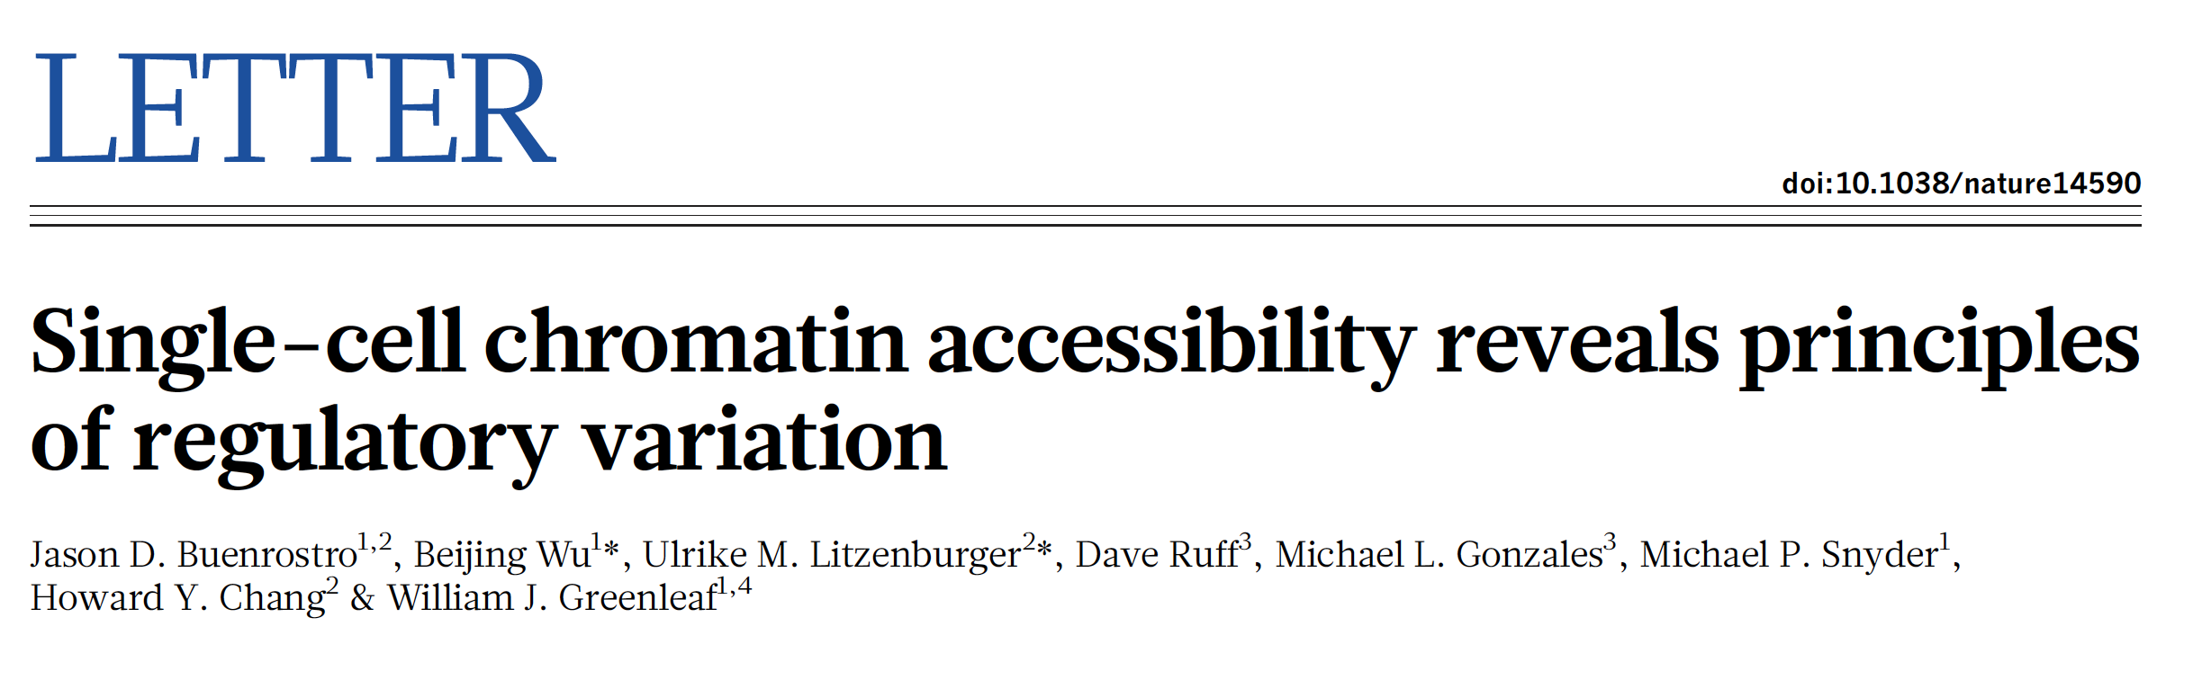
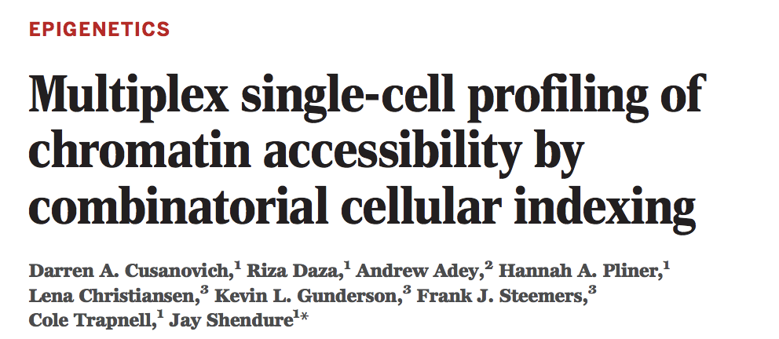
‘Phase 1’ Technologies for scATAC
Buenrostro et al. Nature (2015)
Cusanovich et al. Science (2015)

Slide 26
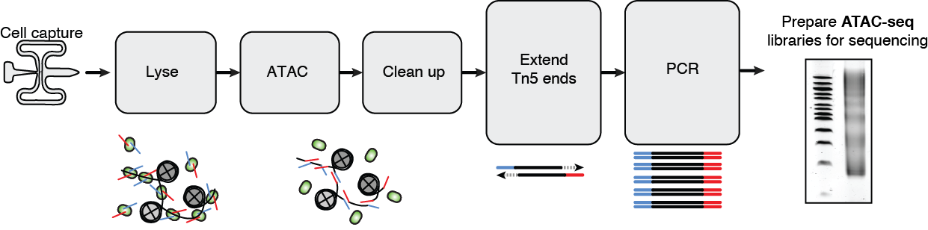
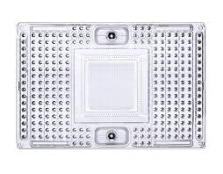

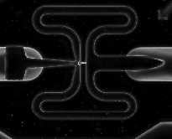
Fludigm C1 (Buenrostro et al. Nature 2015)
Buenrostro et al. Nature (2015)

Slide 27
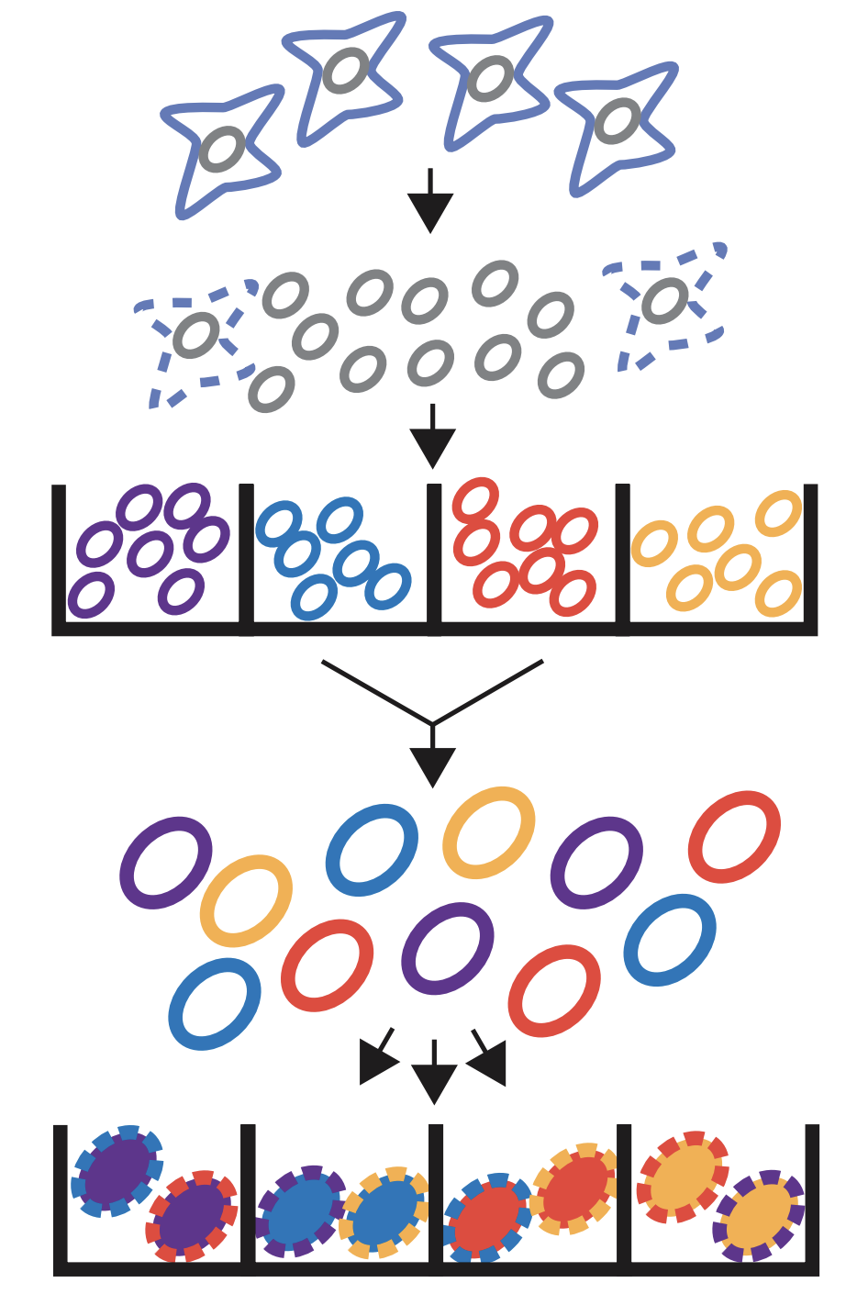
Split-pool (Cusanovich et al. Science 2015)
Cusanovich et al. Science (2015)

Slide 28
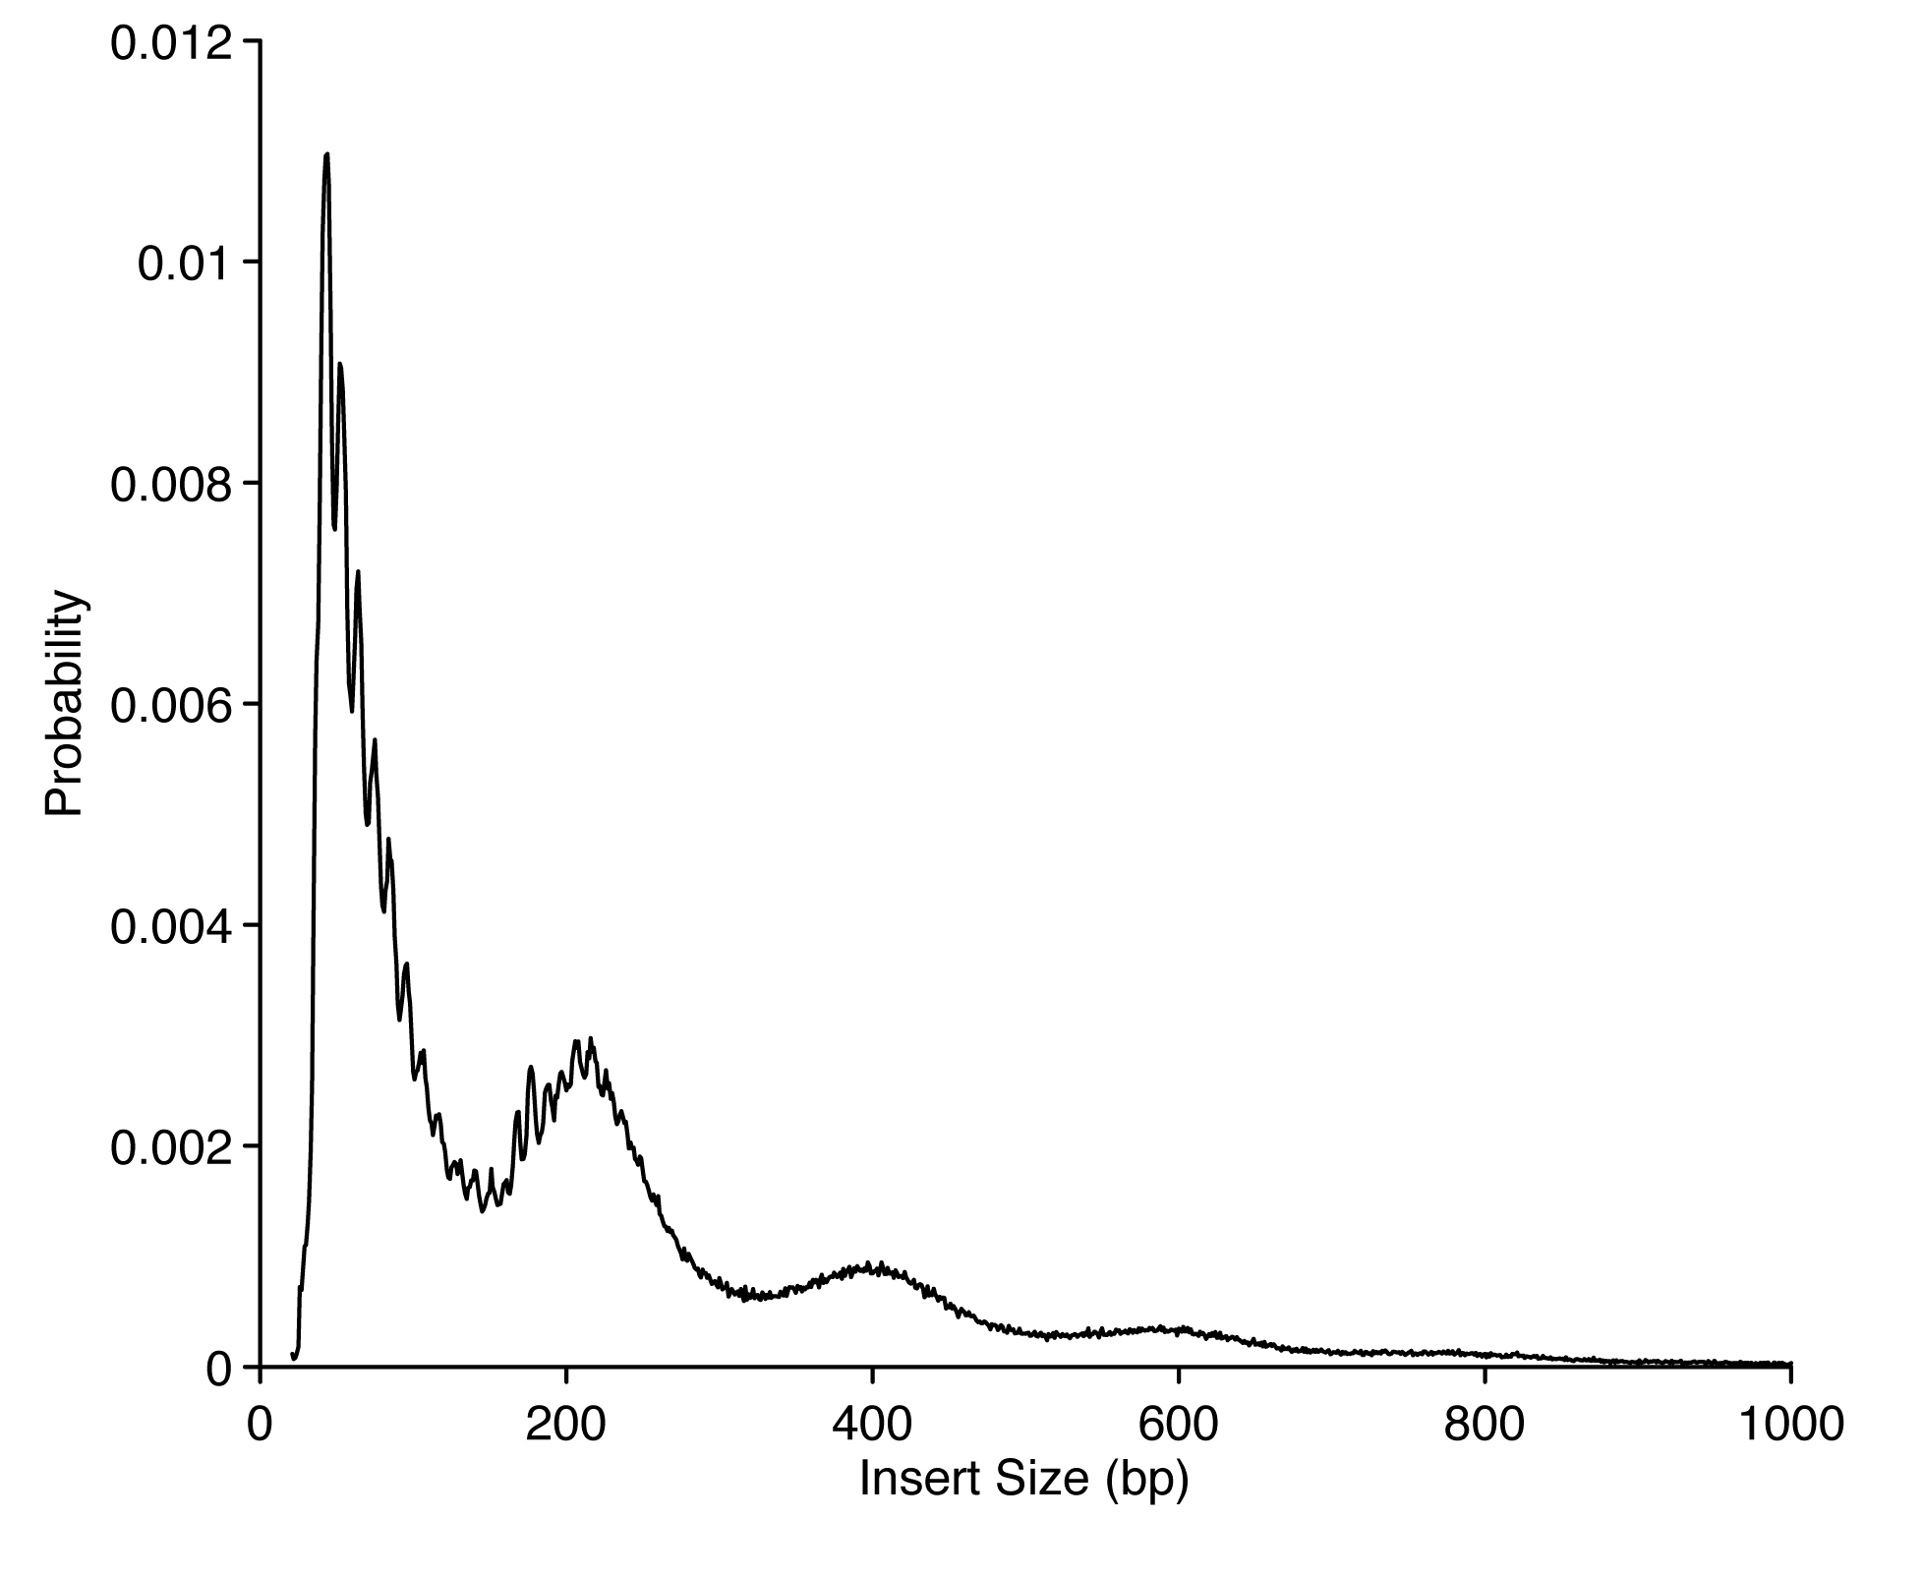
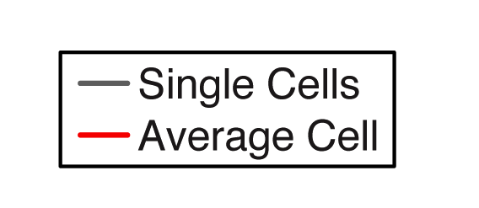
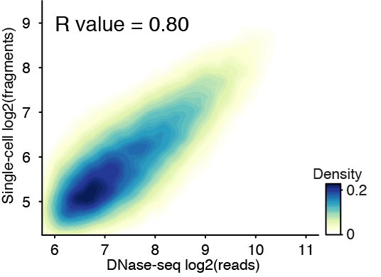
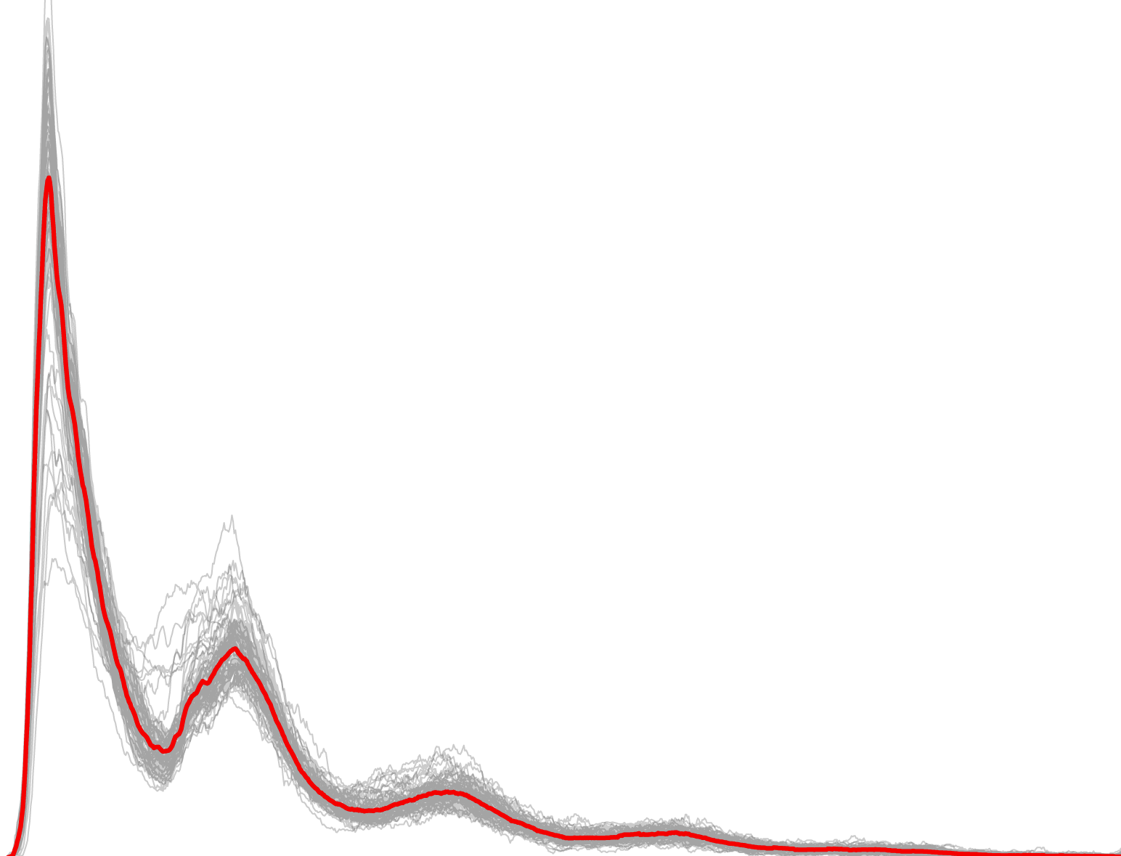
scATAC-seq accurately measures chromatin accessibility
50,000,000 cells
50,000 cells
254 single-cells
Mean: 0.08 fragments per peak
Buenrostro et al. Nature (2015)

Slide 29
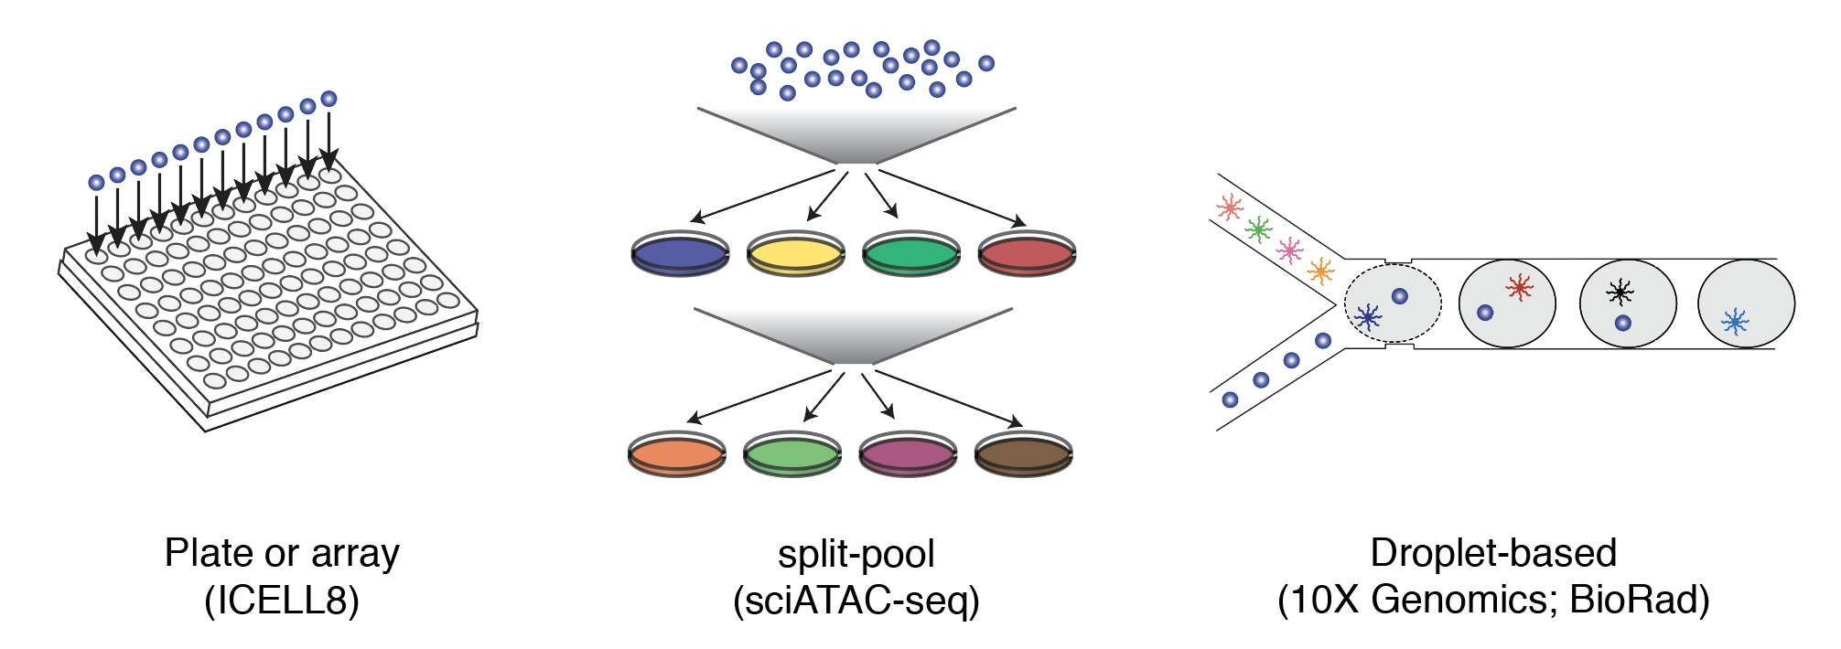
‘Phase 2’: Improved technology → Improved data
Satpathy et al. Nat. Biotech (2019)
Lareau et al. Nat Biotech (2019)
Mezger et al. Nat. Comm (2018)
Lake et al. Nat. Biotech (2019)
Cusanovich et al. Cell (2018)

Slide 30


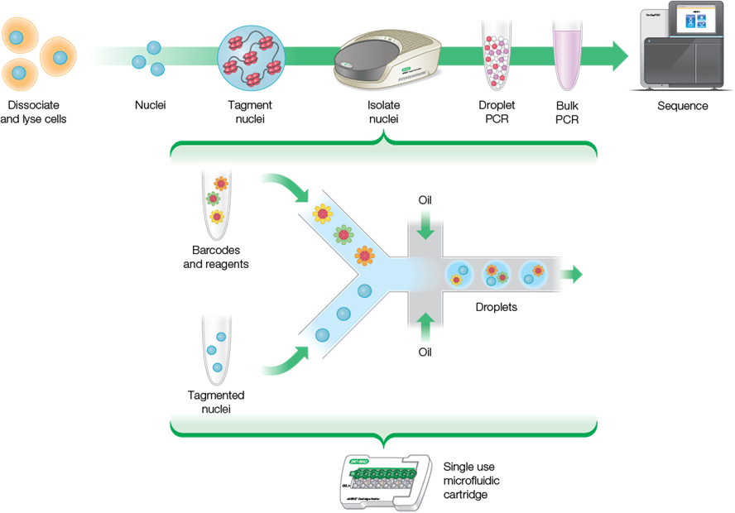
Overview
Total workflow time:
8 hours
BioRad Life Sciences

Slide 31
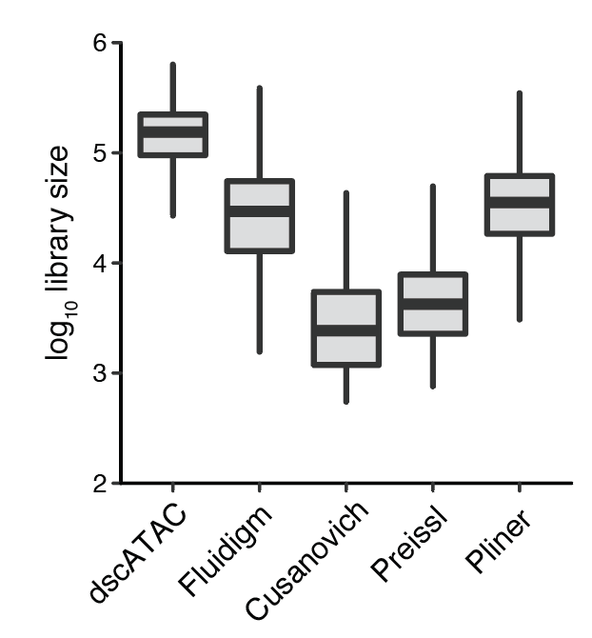
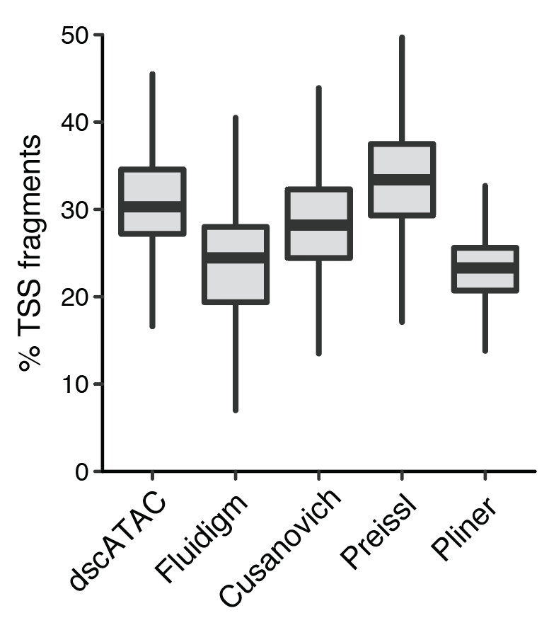
Improved data quality
Droplet based protocols (10x + BioRad)
provide the highest per-cell data abundance
compared to other technologies
Also enable thousands of cells per experiment
Lareau et al. Nature Biotechnology (2019)

Slide 32


These products are commercially available
See: Lareau et al. Nature Biotechnology (2019)
See: Satpathy et al. Nature Biotechnology (2019)
→ The development of these technologies now position scATAC-seq ~ scRNA-seq

Slide 33
Summary
Phase 1 technologies (2015) largely revealed epigenomic heterogeneity in cell lines with limited cell throughput
Phase 2 technologies (2018-2019):
Improve data quality by 1-2 orders of magnitude
Increase cell capture by 1-2 orders of magnitude
Are extremely cost-effective
Commercially available
Can be broadly applied to primary tissues

Slide 34
Part IV: Single-cell ATAC analyses

Slide 35
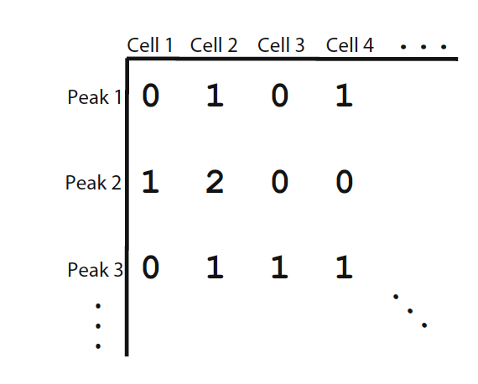
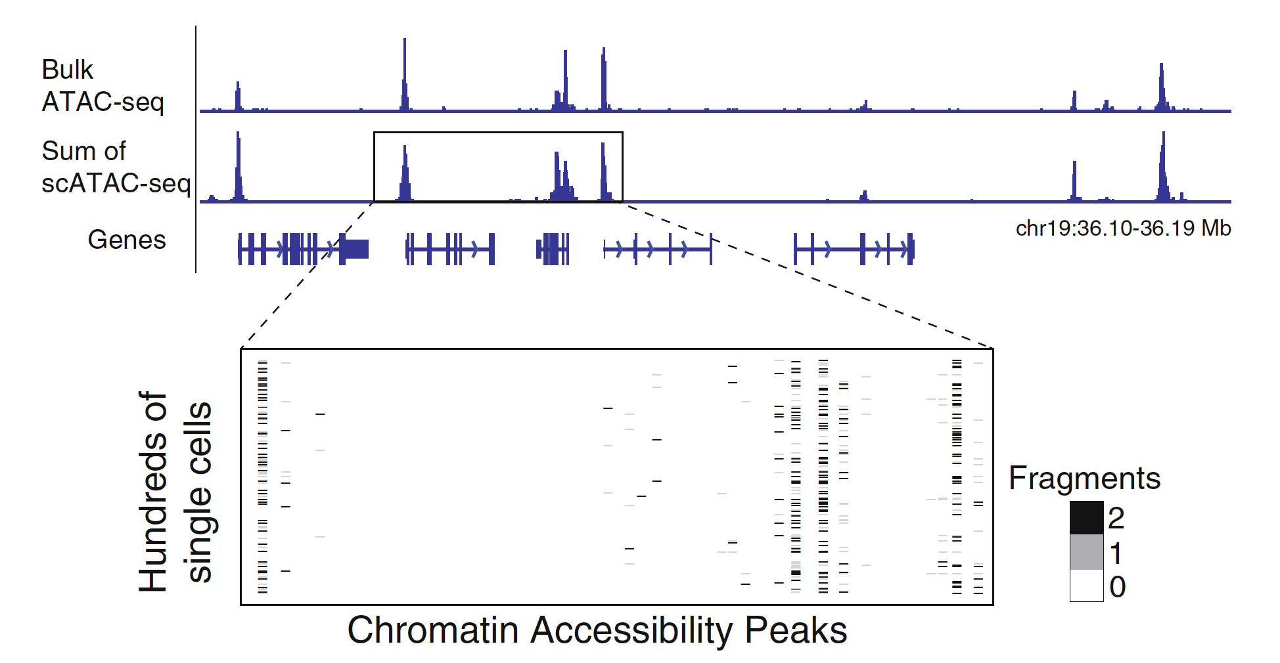
How do we think about scATAC analyses
Nucleosomes, footprints, etc.
Currently unexplored in scATAC
Lareau et al. Methods in Molecular Biology (2019)

Slide 36
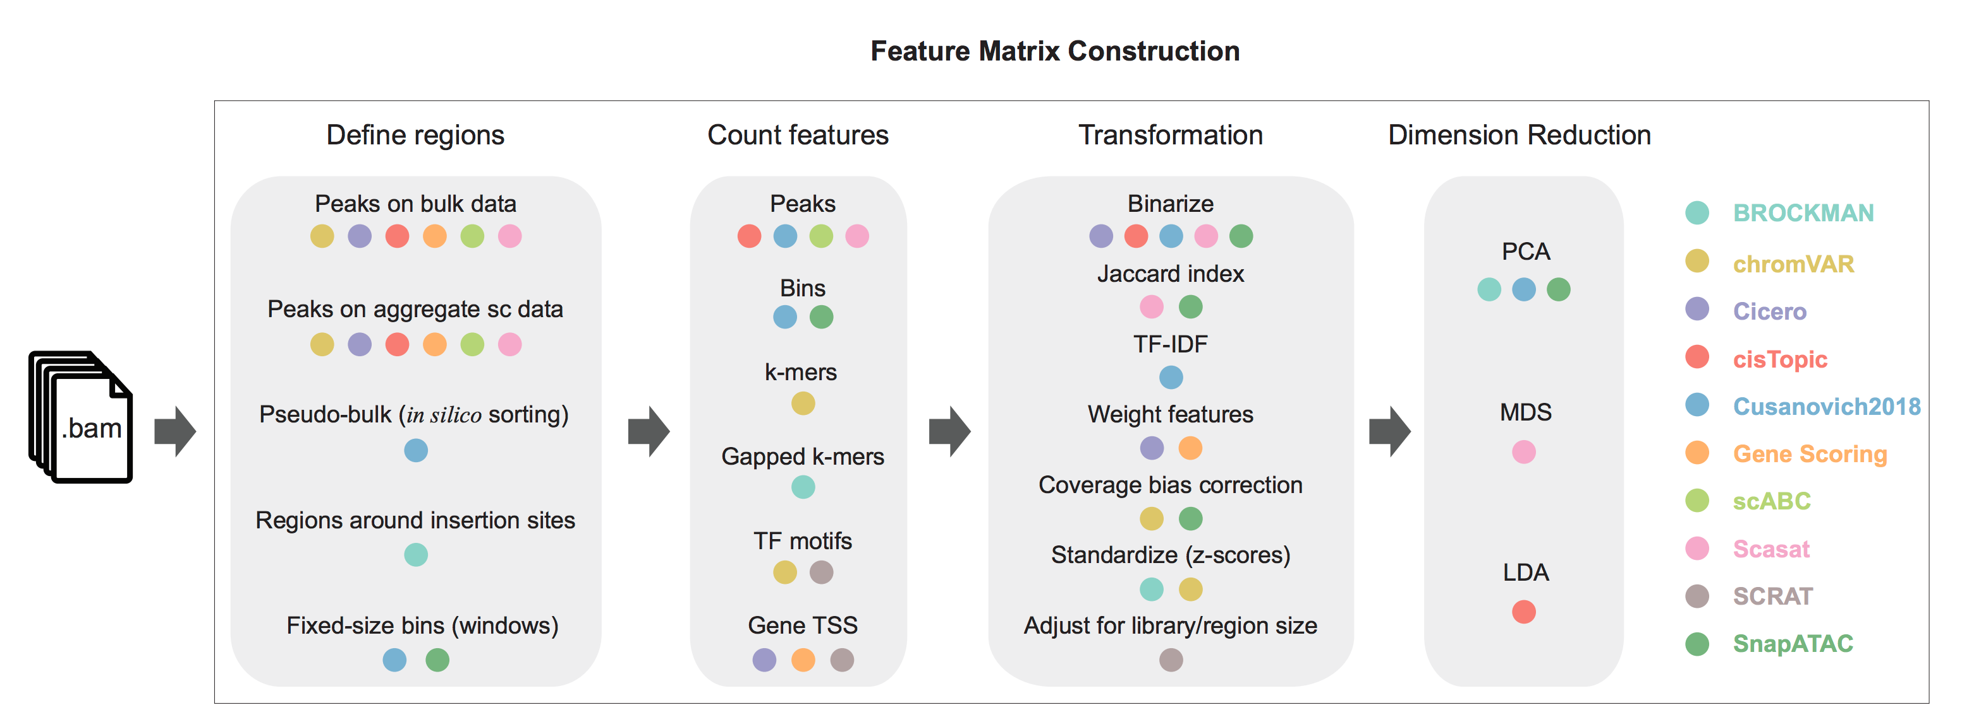
Modes of dimension reduction in scATAC
→ Three main modes of analysis
Chen et al. Genome Biology (2019)

Slide 37
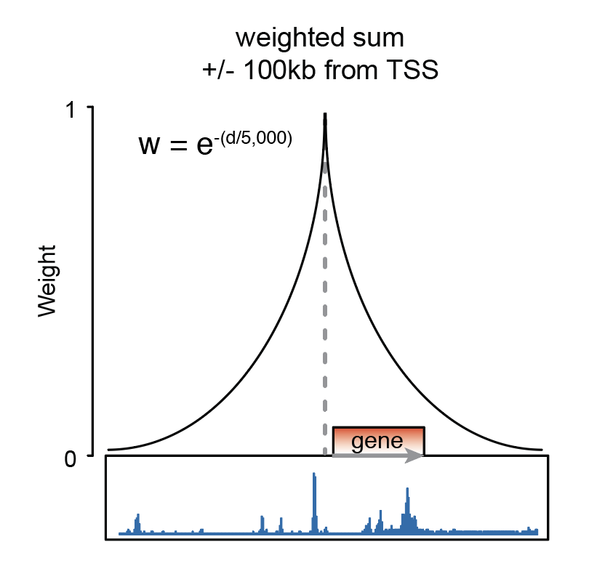
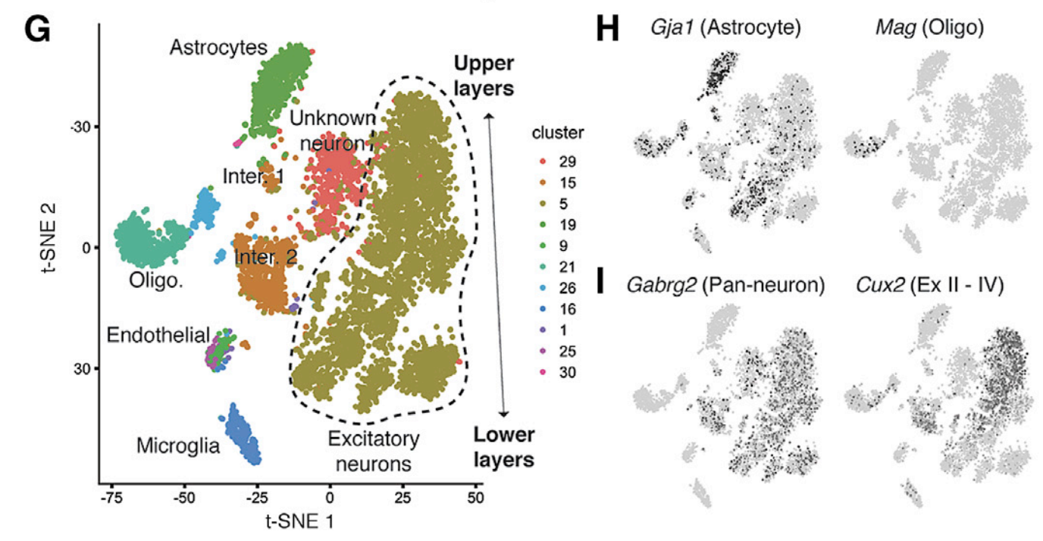
1. Gene scoring (e.g. Cicero)
Cicero: Pliner et al. Mol. Cell (2018)

Slide 38
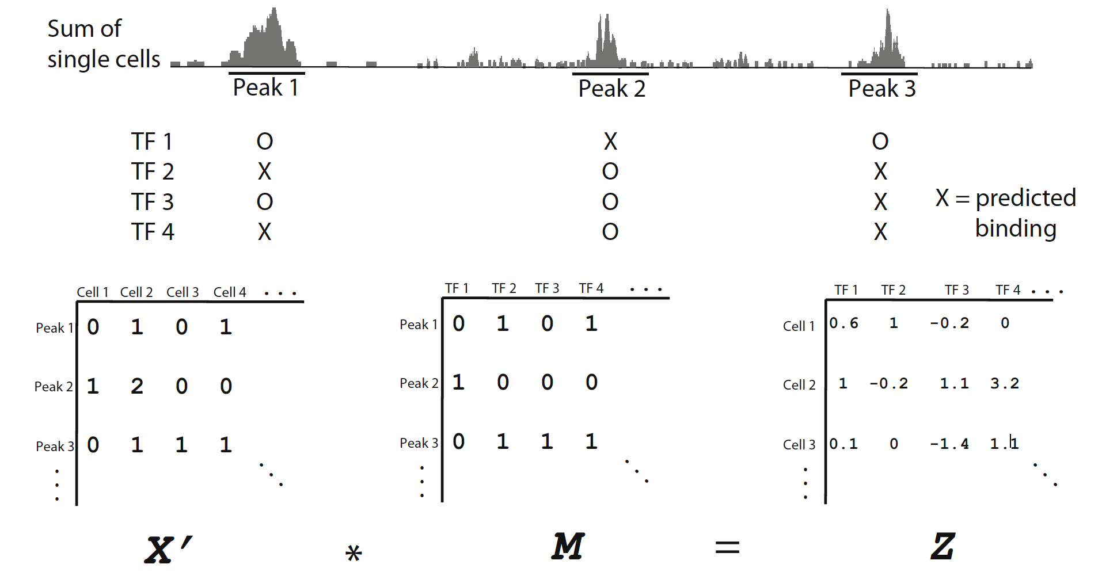
2. Kmer / motif scoring (e.g. chromVAR; BROCKMAN)

Slide 39
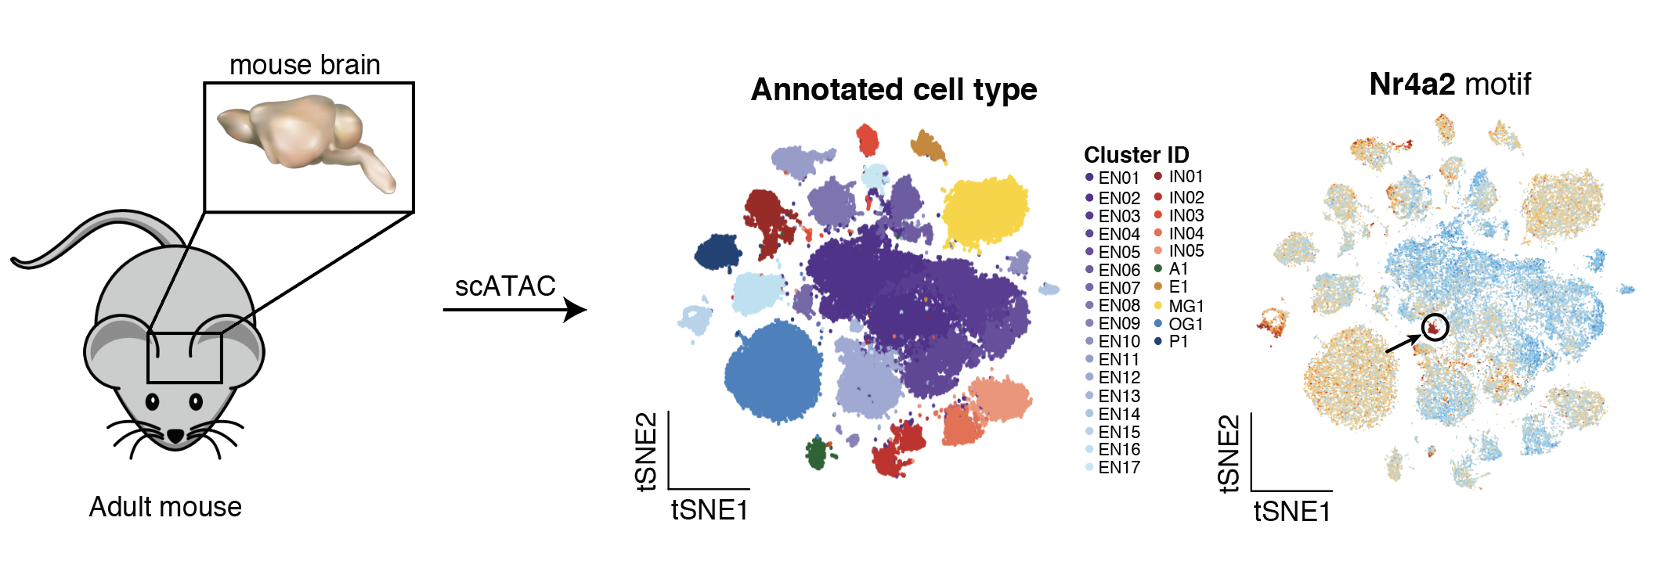
Annotating cell states with TF activities
Lareau et al. Nature Biotechnology (2019)

Slide 40
3. Genomic loci as features (e.g. CisTopics; SnapATAC)
PCA
Feature selection?
LSI
Normalization?
LDA
Jaccard Index
→ How to define regions?

Slide 41
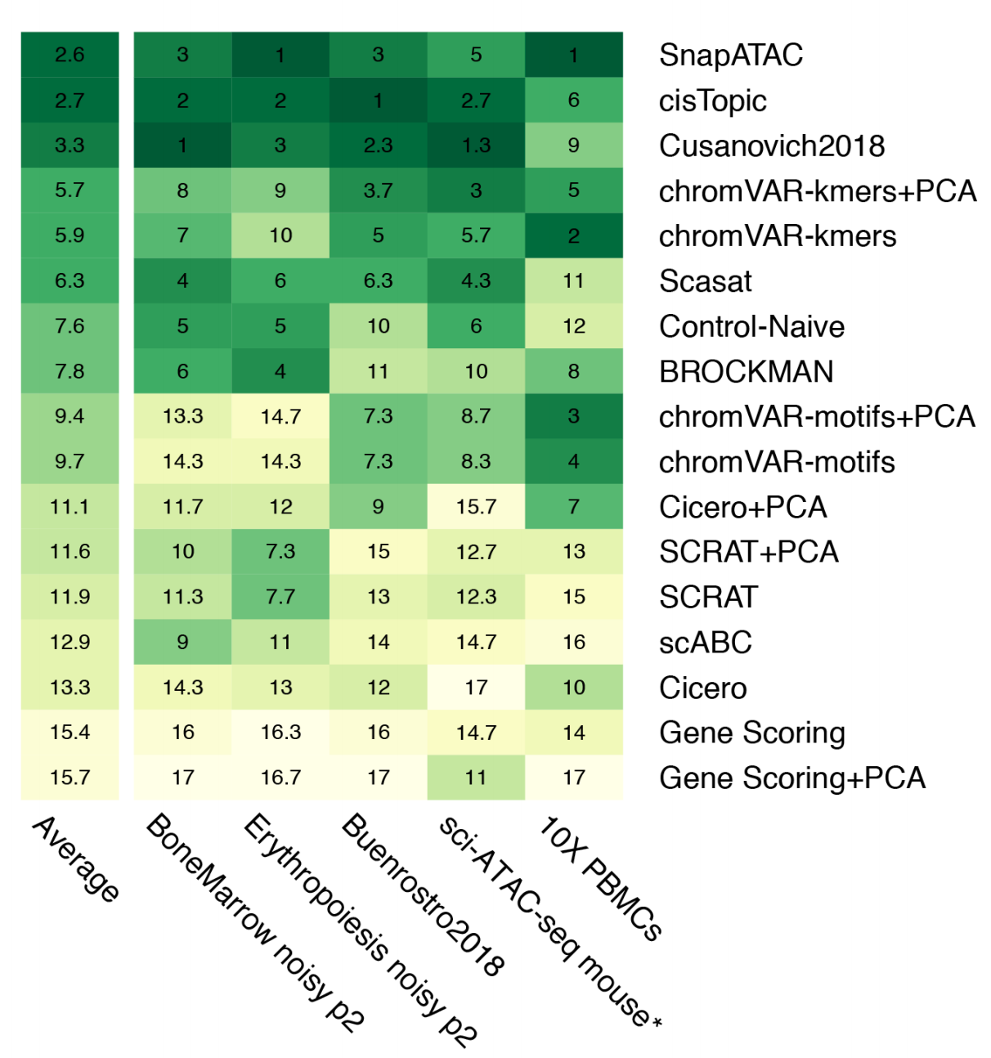
Summary of computational performance
Genomic coordinates
Motif / Kmer based
Proximity to TSS
Chen et al. Genome Biology (2019)

Slide 42
Defining regions / peaks for scATAC-seq
Method | Description | Pros | Cons
Naive | Call peaks with single-cell sample as if bulk | Easy | Cannot distinguish rare cell types
Bulk guided | Aggregate summits from bulk experiments | Can we well-annotated biologically | Biasing against new cell-types
SnapATAC | Use 5kb bins to perform all analyses; don’t worry about peaks | Peak-agnostic | Limited resolution?
Cusanovich2018/ Satpathy2019 | Pre-cluster cells using LSI for 5kb bins; create synthetic bulks per cluster; call peaks | Best sensitivity and most comprehensive | Somewhat computationally intensive; no turn-key tool

Slide 43
Best practices for scATAC-seq analyses
Retaining peak x cell matrix provides the highest resolution for downstream analyses but defining features is not trivial
More on this in the tutorial…
Gene scoring and TF/Kmer scoring are great for annotation
Less appropriate for dimension reduction / clustering
Newer methods using autoencoders could provide utility but aren’t *quite* there (in the TA’s opinion)

Slide 44
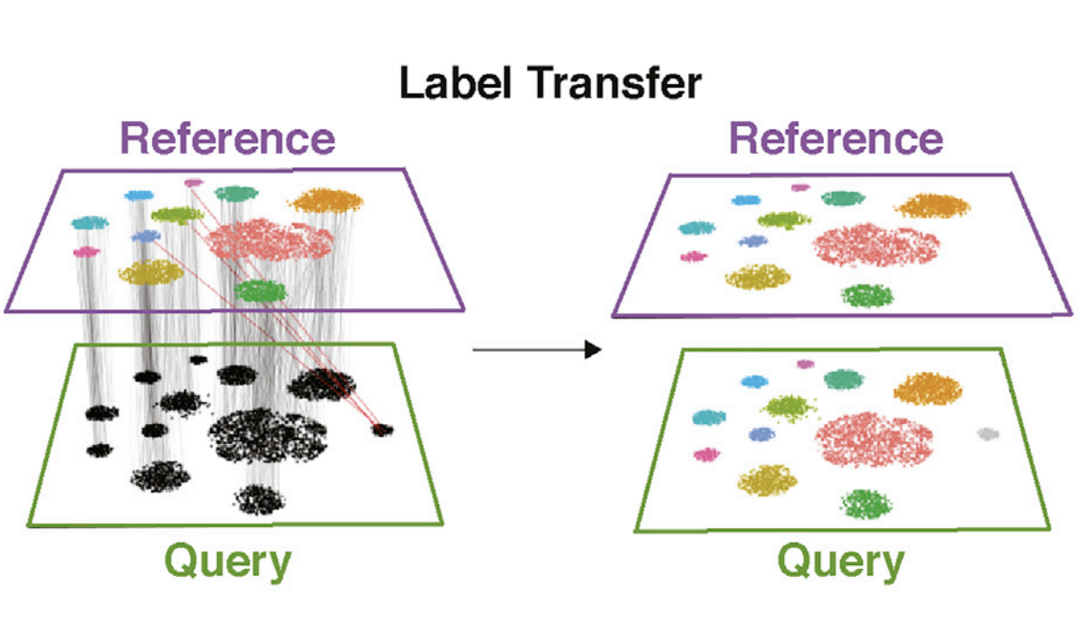
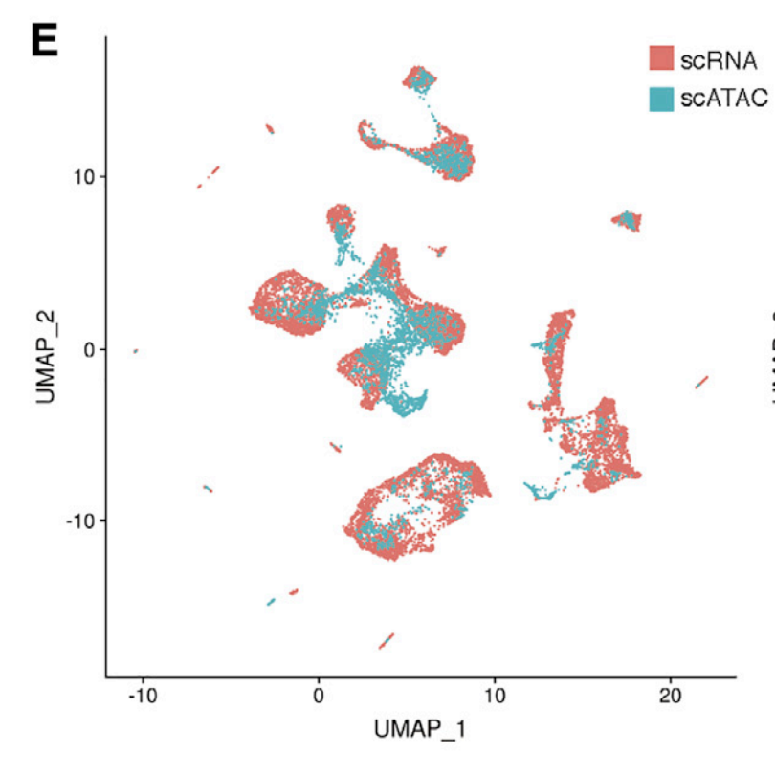
Data integration
Stuart et al. Cell (2019)

Slide 45
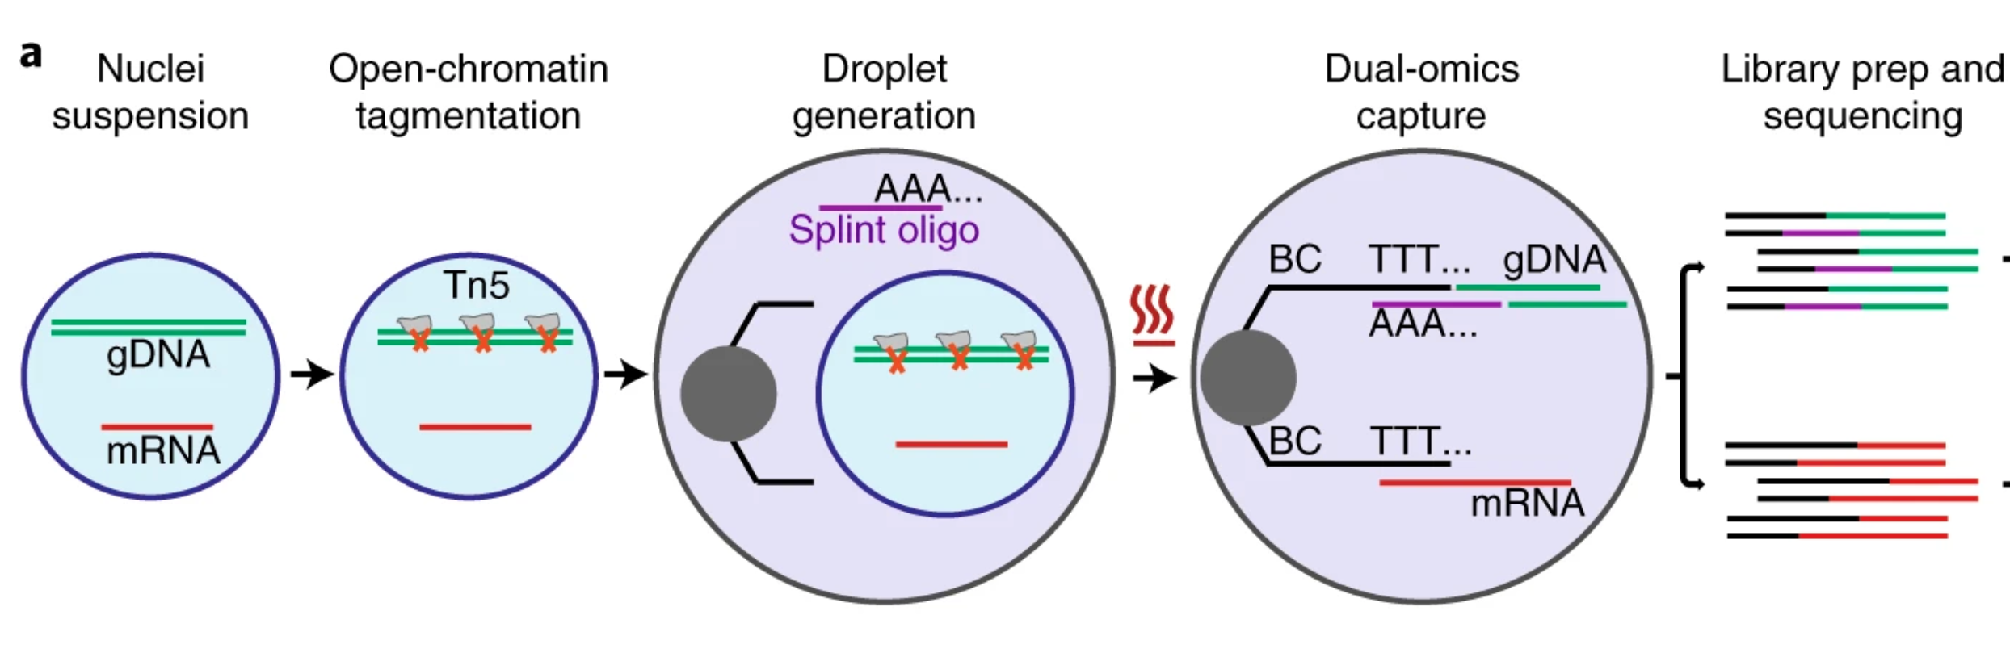
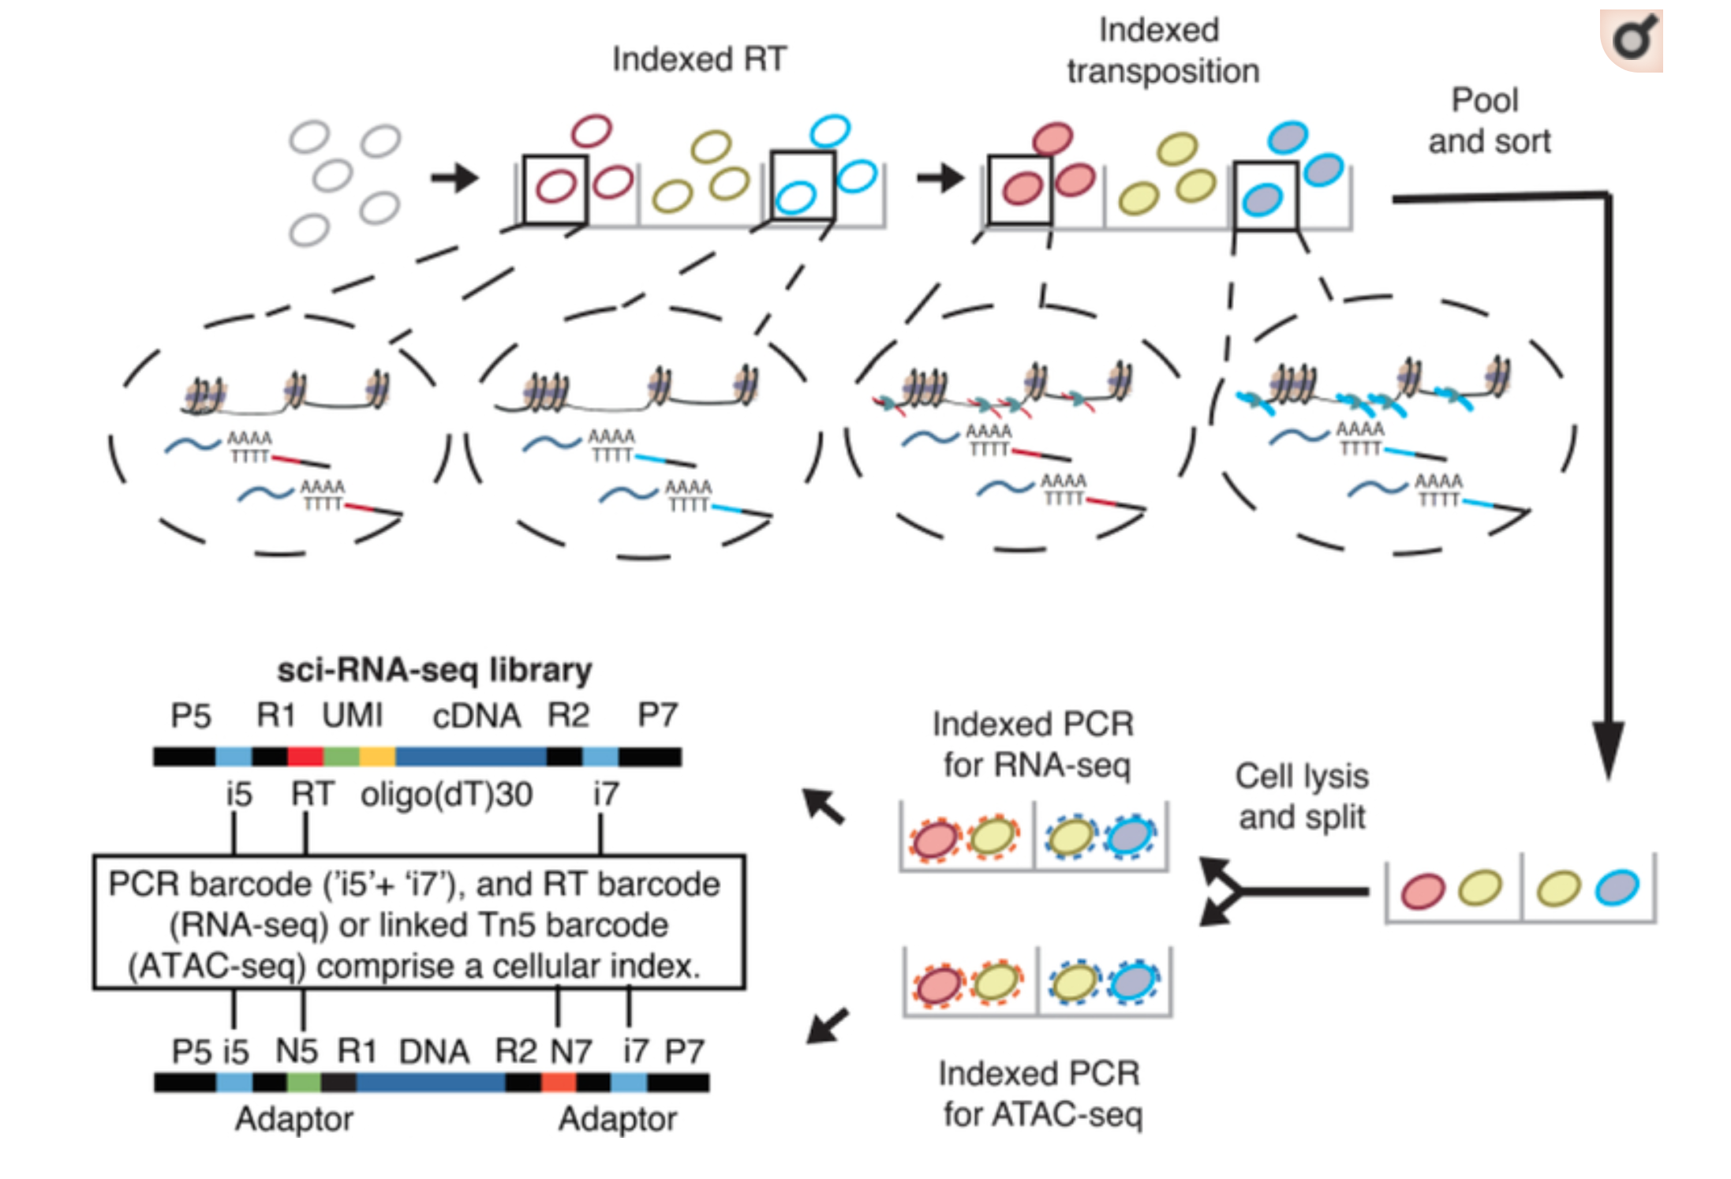
Multi-modial –omics w/ ATAC-seq
sciCAR: Cao et al. Science (2018)
SNARE-seq: Chen et al. Nature Biotechnology (2019)

Slide 46
Three ‘take home’ points
Bulk ATAC-seq is only 6 years old and provides much more information than just “signal tracks”
- New innovations leverage this approach
Improved cell lysis and droplet microfluidics converged to make powerful, widely-available assays
- Phase 2 >>> Phase 1 scATAC-seq technologies
Computational methods that preserve the read in peak structure generally outperform other approaches
- TFs + gene scores are still extremely valuable for annotation of cell types

Slide 47
Thank you

